Slide 1
Calibration Services Inc.
CIS 411
Austin Barger, Collin Switzer, Jake Rice, Prince Brooks
Notes:
Austin

Slide 2
The Company
Calibration Services Inc. is an on-site and in-house calibration firm specializing in calibration, and service of mechanical testing devices.
Provides services to 11 US states, territories, and Canada.
Calibrate in excess of 1000 machines for clients per year.
Notes:
Austin

Slide 3
The Problem
Convert the old Microsoft Works database into a more modern solution for the company’s future generations
Works Database full of redundancies/incomplete data/no headings
Works is outdated/No longer maintained
Use of physical mediums to track progress
Notes:
Austin

Slide 4
Primary Goals
Goals we absolutely had to accomplish.
Convert and host Works database on mySQL
Remove need for physical progress trackers (Bulletin Board/Weekly Schedule)
Notes:
Austin

Slide 5
Secondary Goals
Revising of weekly schedule/bulletin board.
Who they are for/ what info is displayed
Generate Solicitation letters and send them to clients.
Backup versions of work orders
Notes:
Prince

Slide 6
Technologies Implemented
mySQL
HTML/CSS/Javascript/PHP
DataTables, JQuery, Bootstrap
Xampp
phpMyAdmin
Notes:
Austin

Slide 7
Works Conversion
Convert Works to Libre-Office, save as Excel
Define column meanings
Write script
Notes:
Prince

Slide 8
The MYSQL Database
Simple to Use
Add Customers
Job Sites, Contacts, Machinery
Edit Customer Info
Info to be used by other pages
Notes:
Collin

Slide 9
Database Description
Customer
Tax Info, status, scheduling, date acquired, solicitation info
Job Site
Contact, phone, address, hours, directions
Contact
Name, department, phone, fax, email, billing info
Machinery
MD, Range, Pricing Info, Serial Number
Notes:
Collin

Slide 10
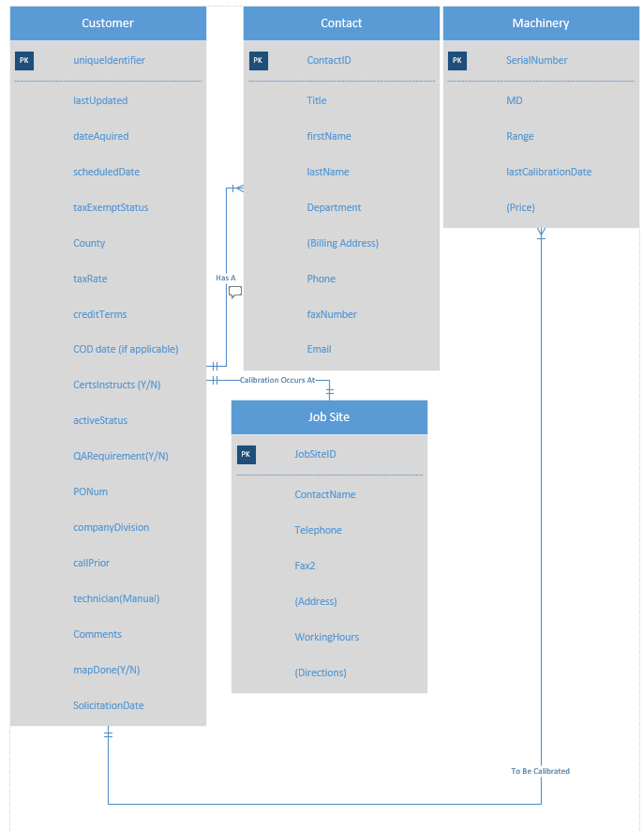
The Database
Notes:
Collin

Slide 11
The Script
Second step in our process
SQL
Excel Spreadsheet
For each table we used @dummy variables to pass over columns we did not want
Named columns where we did require that columns data
Tedious/Time Consuming
Notes:
Prince

Slide 12
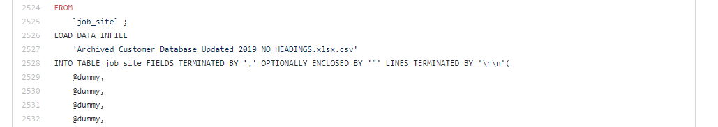
The Script
Notes:
Prince

Slide 13
Security / Login
Salted & Hashed Password Storage
Users can be added once signed in
Local
limitations

Slide 14
Main Page
Database View
Simple Vs. Advanced View
Sub Tables
Machinery, Job Sites, Contacts
Add Form
Machinery, Job Sites, Contacts
Edit + Delete

Slide 15
Current Bulletin Board
Paper bulletin board
Posted on wall
Progress marked with bingo dauber by office administrator
Notes:
Prince

Slide 16
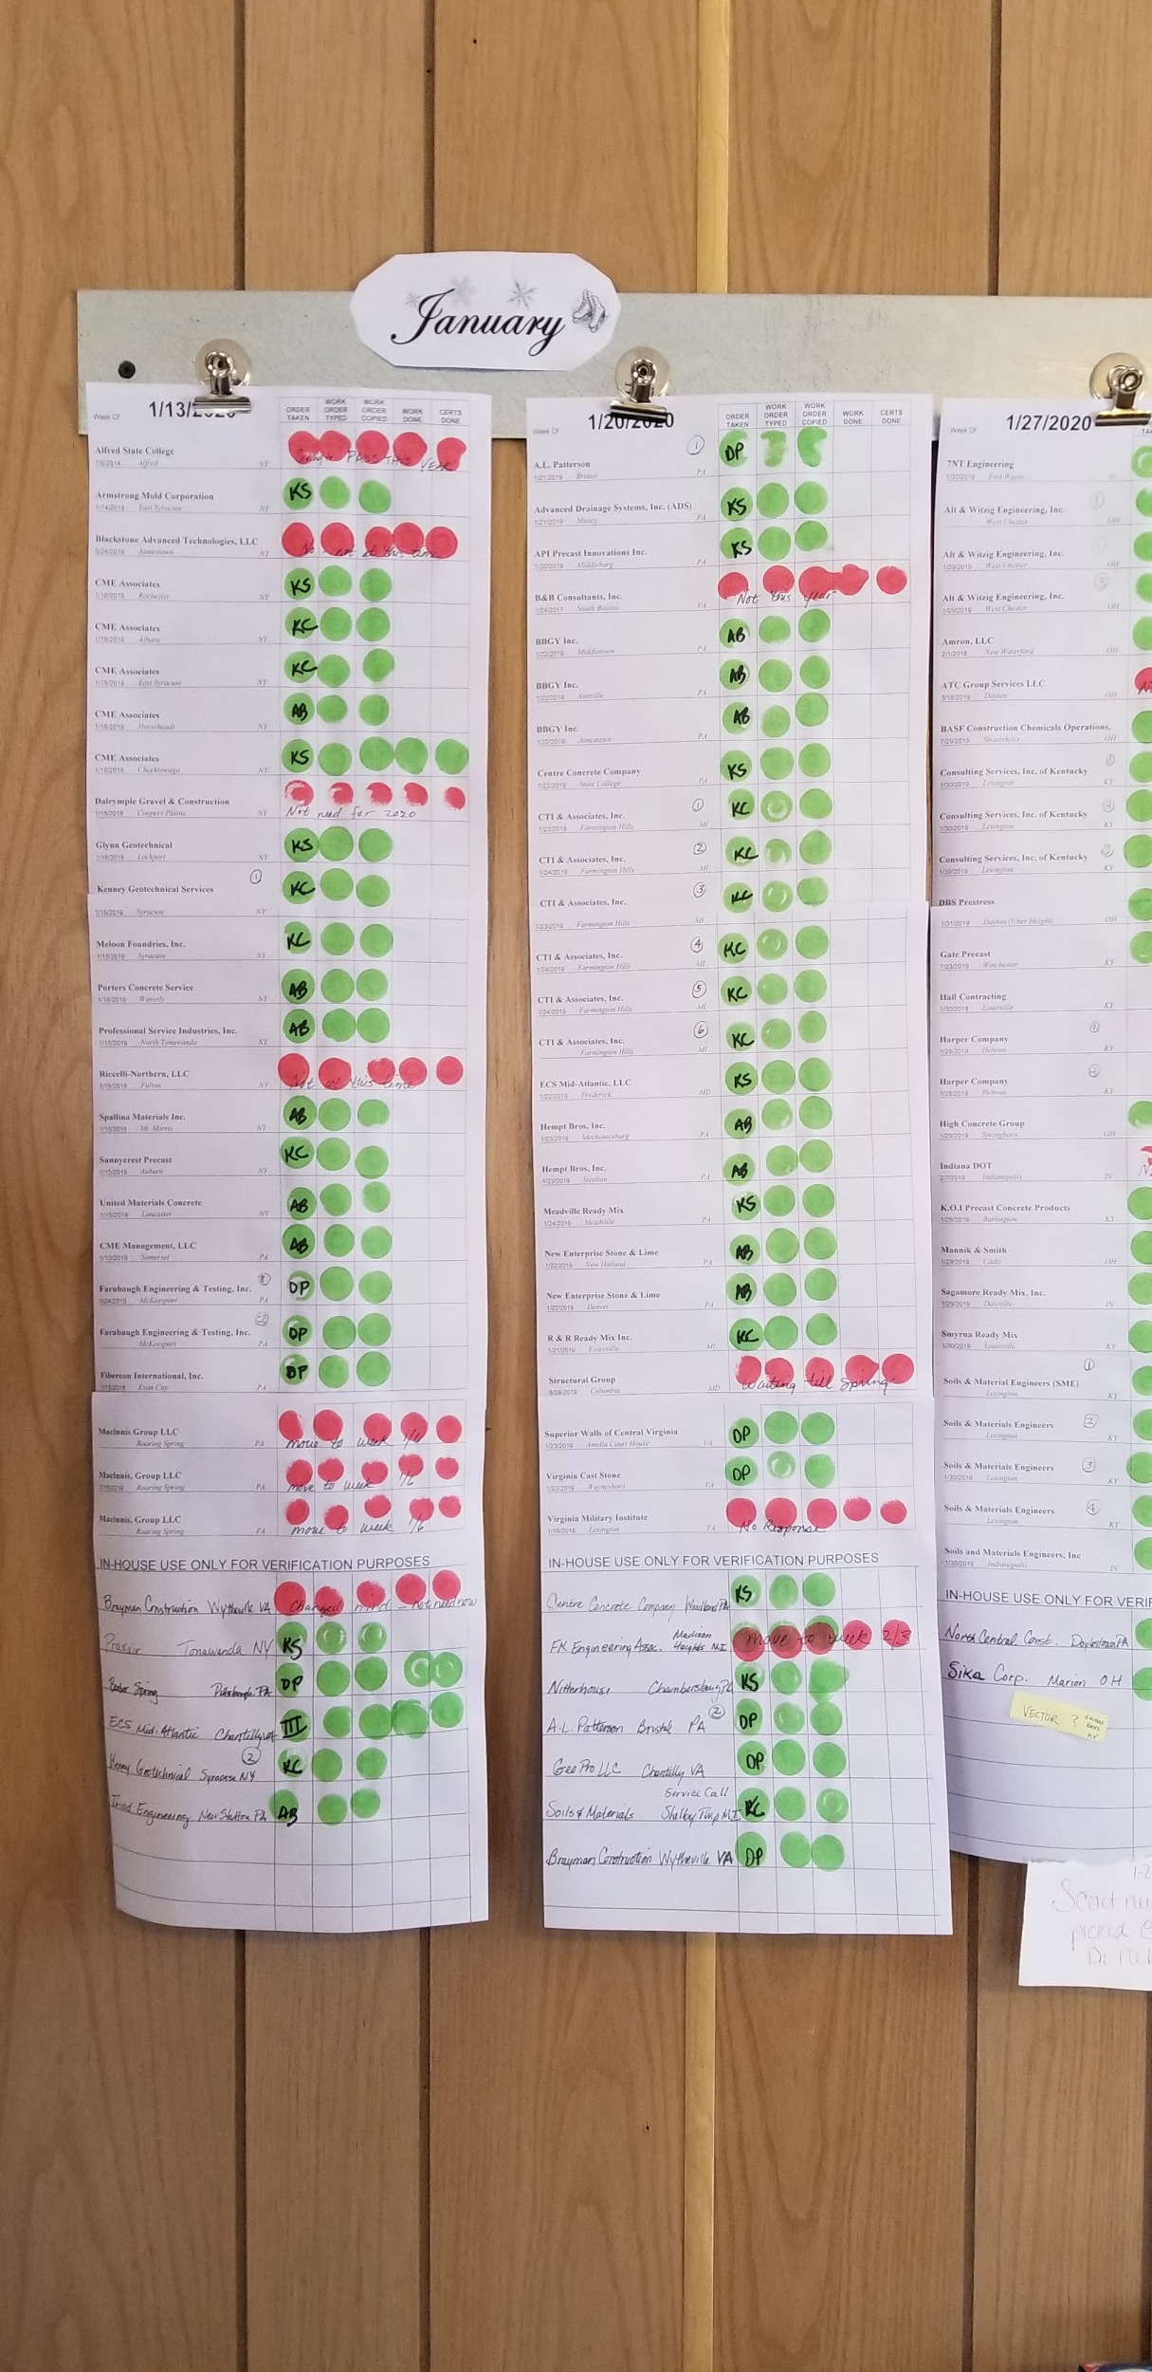
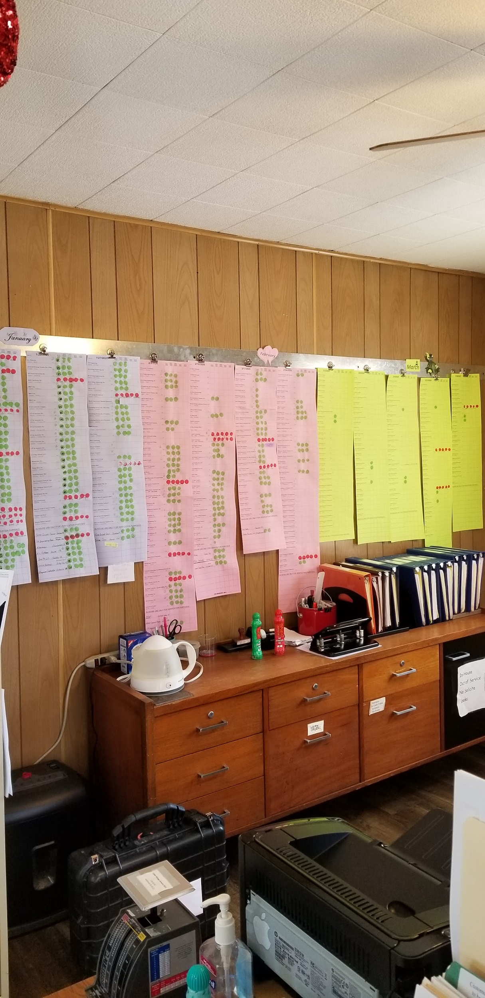
Current Bulletin Board
Notes:
Prince

Slide 17
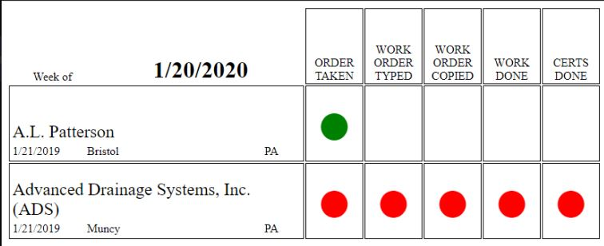
Current Bulletin Board
Notes:
Prince

Slide 18
Bulletin Context
Order Taken
Work Order Typed
Work Order Copied
Work Done
Certs Done
Notes:
Prince

Slide 19
Difference from Last Meeting
Only utilized javascript to add customer to bulletin board table
Did not display by month
Could not deal with database records
Notes:
Prince

Slide 20
How Did We Implement?
Added fields to customer table
Correspond with Unique Identifier
Order Taken, Work Order Typed, Etc.
Notes:
Prince

Slide 21
New Bulletin Board
Digital / Front End View
Able to view by month
Able to mark progress
Displays current months bulletin board on load
Notes:
Prince

Slide 22
Weekly Schedule
Meant to be given to technicians to keep track of what they need to do while on a tour
Specific to each technician and different each week of the year
Gives a quick overview of where each tech has to visit that week
Notes:
Jake

Slide 23
Accomplished Goals
Converted Works database
New database host (phpMyAdmin)
Fully functional front end database view (CRUD)
Fully functional Bulletin Board (Update Progress)
Weekly Schedule to assign Technicians
Login Security
Notes:
Jake

Slide 24
Limitations
Solicitation letter messaging system
Work Order document back up.
Notes:
Jake

Slide 25
C.S.I. Demo

Slide 26
Questions?

